Slide 1
WINE-QUALITY
Kinnera Saivalli Veerapaneni
Pravallika Avula
Anurag Goud Koukuntla

Slide 2
Data set
This project has two datasets namely red and white wine samples from the north of Portugal.
Source
https://archive.ics.uci.edu/ml/datasets/wine+quality

Slide 3
Data Description:
This dataset contains 12 attributes and 4898 instances.
The two datasets are related to red and white variants of Portuguese “Vinho Verde” wine.
Variables:
1 - fixed acidity - most acids involved with wine or fixed or nonvolatile (do not evaporate readily)
2 - volatile acidity - the amount of acetic acid in wine, which at too high of levels can lead to an
unpleasant, vinegar taste
3 - citric acid - found in small quantities, citric acid can add 'freshness' and flavor to wines
4 - residual sugar - the amount of sugar remaining after fermentation stops, it's rare to find wines with less than 1 gram/liter and wines with greater than 45 grams/liter are considered sweet 5 – chlorides - Amount of salt present in wine 6 - free sulfur dioxide - the free form of SO2 exists in equilibrium between molecular SO2 (as a dissolved gas) and bisulfite ion; it prevents microbial growth and the oxidation of wine.

Slide 4
7.-total sulfur dioxide - amount of free and bound forms of S02; in low concentrations, SO2 is mostly undetectable in wine, but at free SO2 concentrations over 50 ppm, SO2 becomes evident in the nose and taste of wine 8 - density - the density of water is close to that of water depending on the percent alcohol and sugar content 9 - pH - describes how acidic or basic a wine is on a scale from 0 (very acidic) to 14 (very basic); most wines are between 3-4 on the pH scale 10 - sulphates - a wine additive which can contribute to sulfur dioxide gas (S02) levels, wich acts as an antimicrobial and antioxidant
11 - alcohol - Percent of alcohol present in wine 12 - quality (score between 0 and 10)

Slide 5
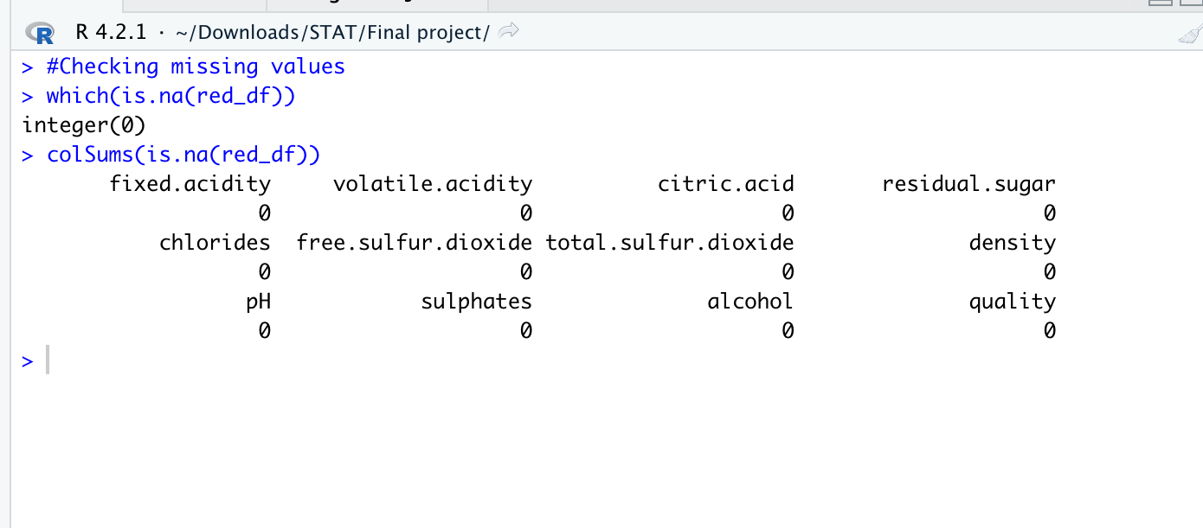
Data Cleaning:

Slide 6
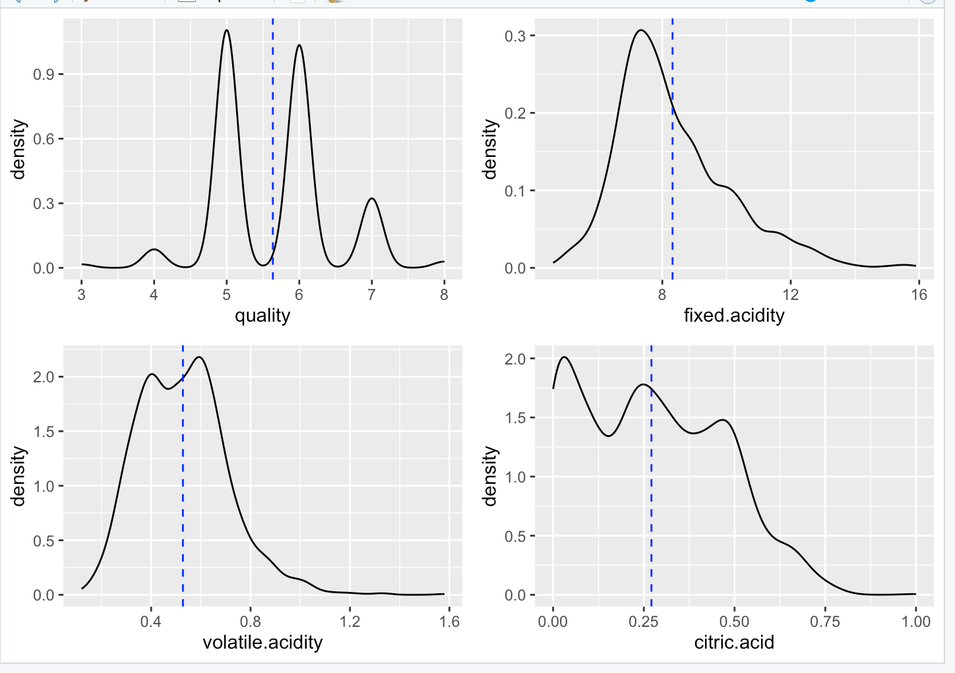
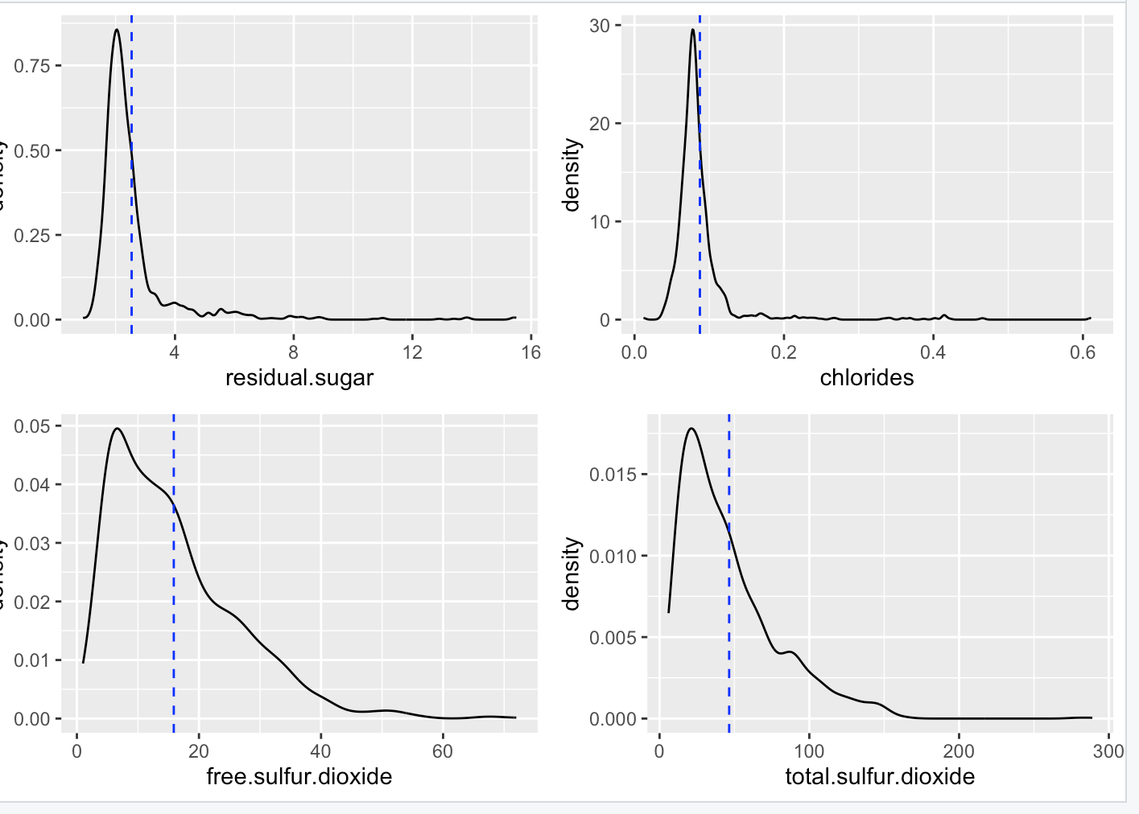
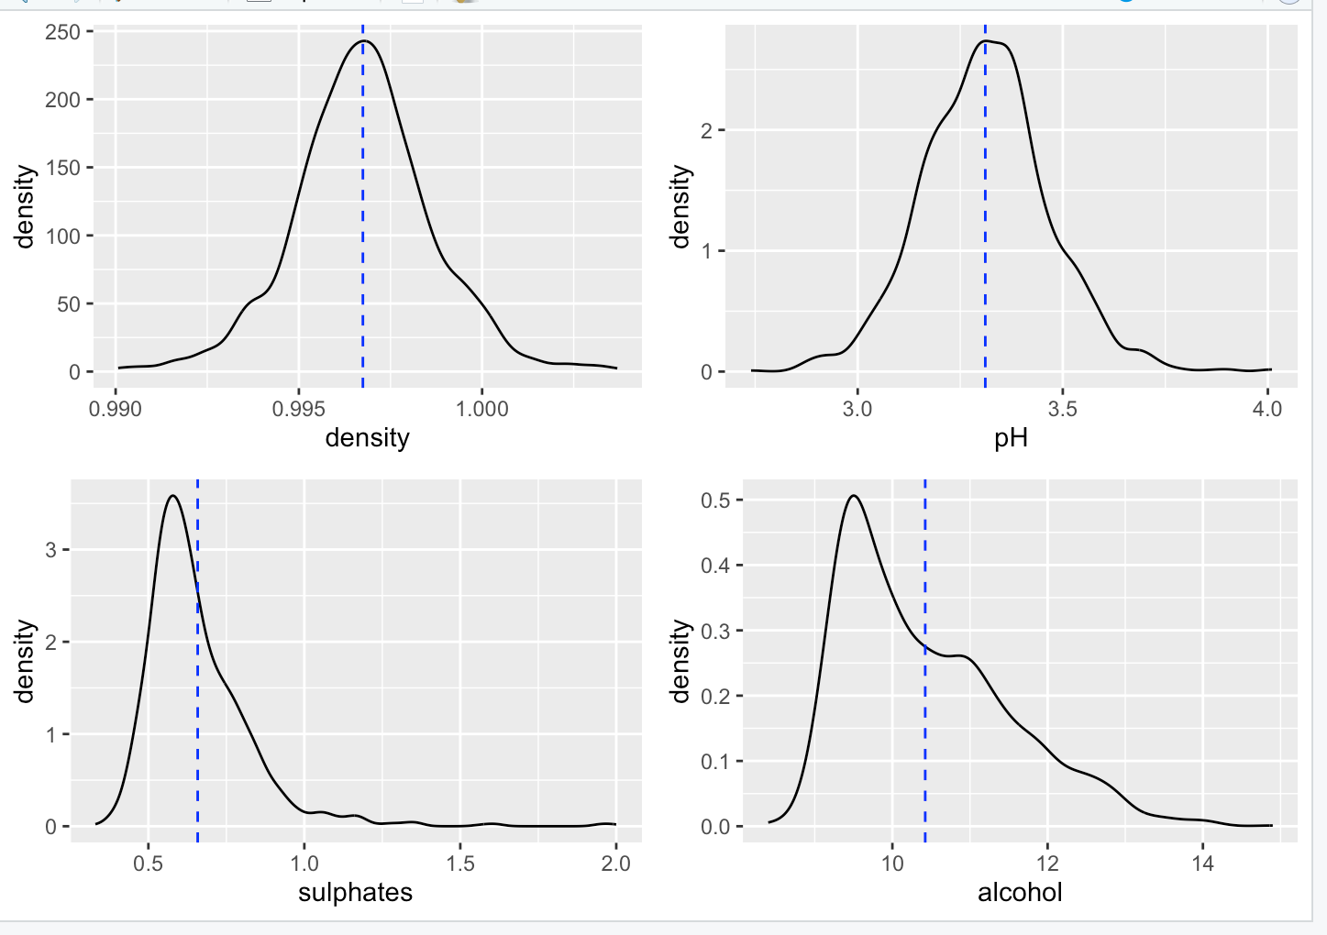
Exploratory Visualizations(Red wine):

Slide 7
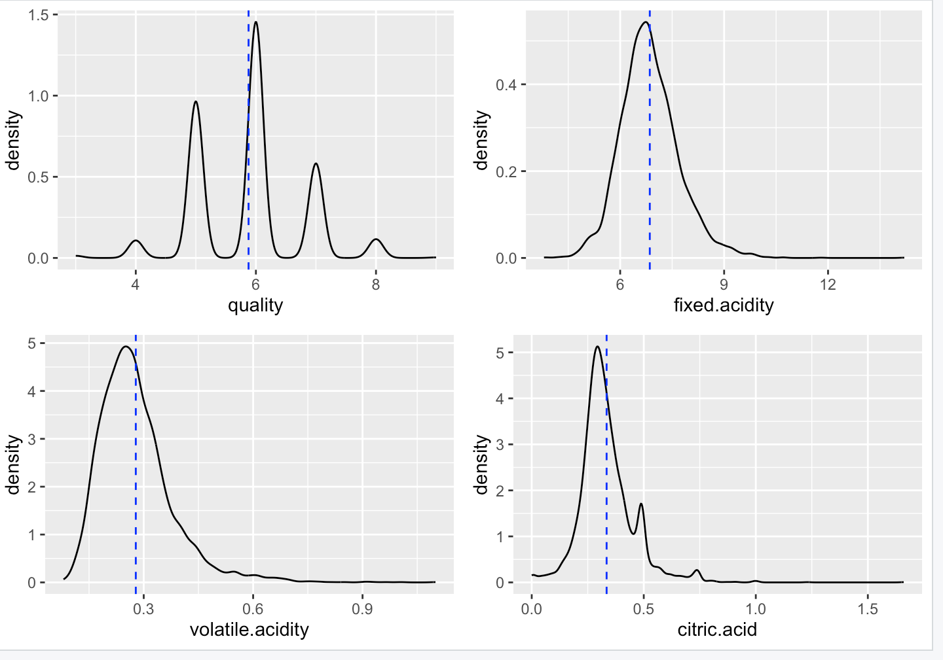
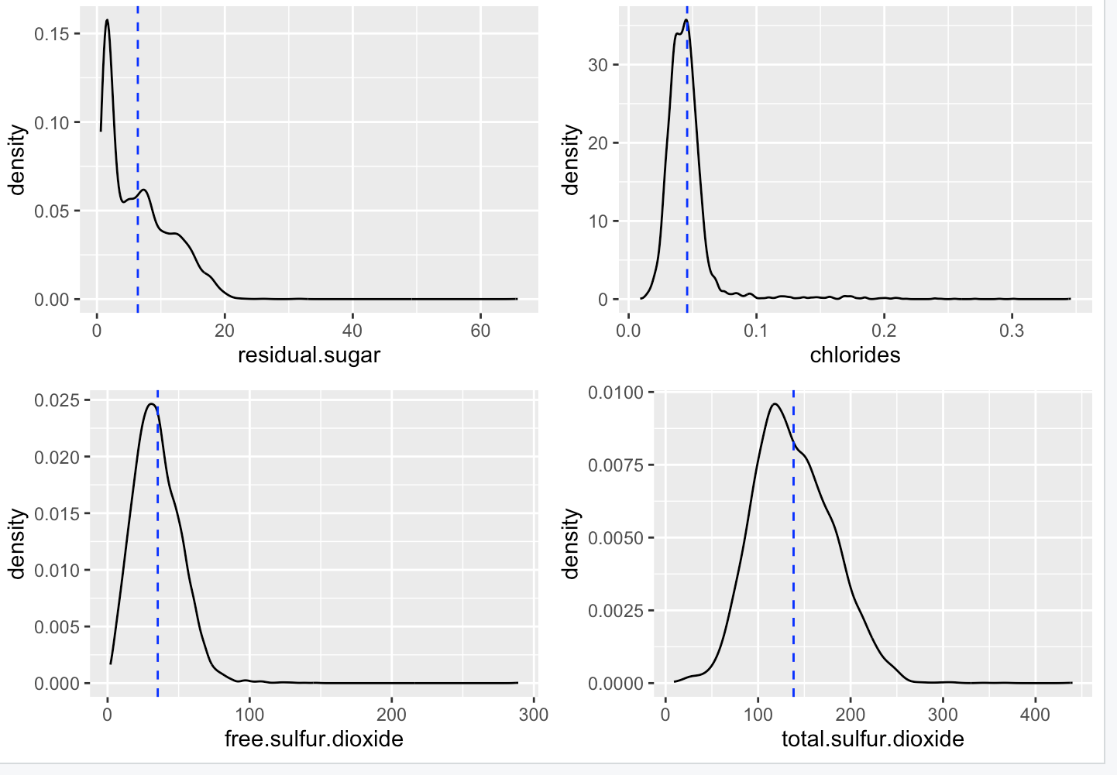
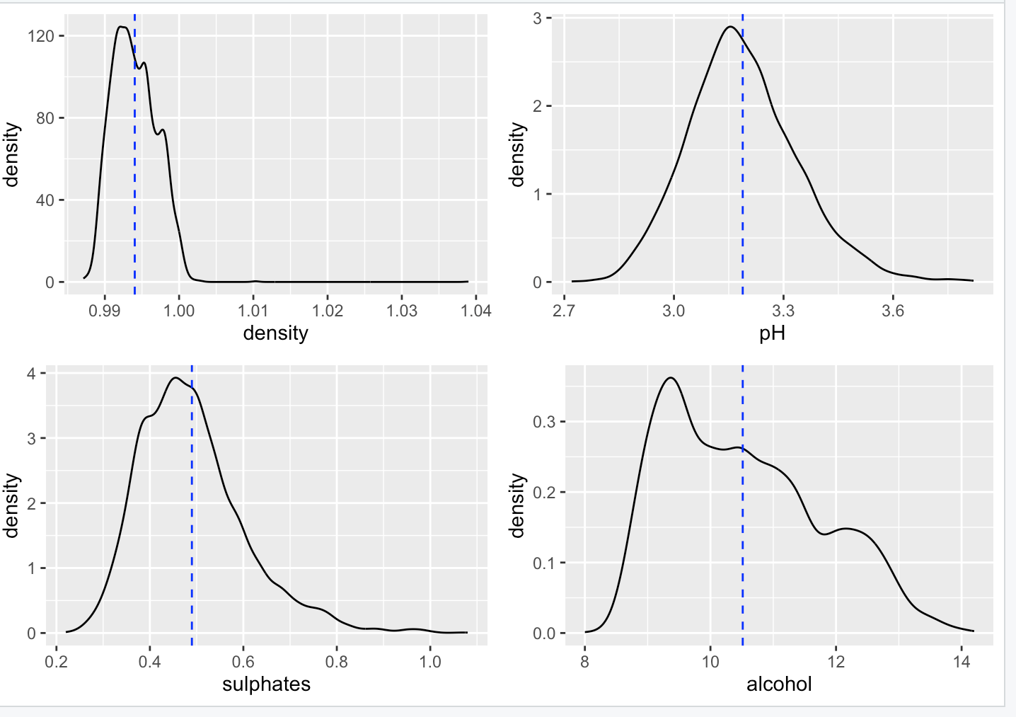
Exploratory Visualizations(White wine):

Slide 8
Research Questions:
How are the predictors related to each other?
Which one has more better-quality red or white?
What wine features are important to get a promising result?
Which regression method can give accurate results?
At what Ph the quality of red wine and white wine are similar?
Can a model be built that predicts quality of wine?

Slide 9
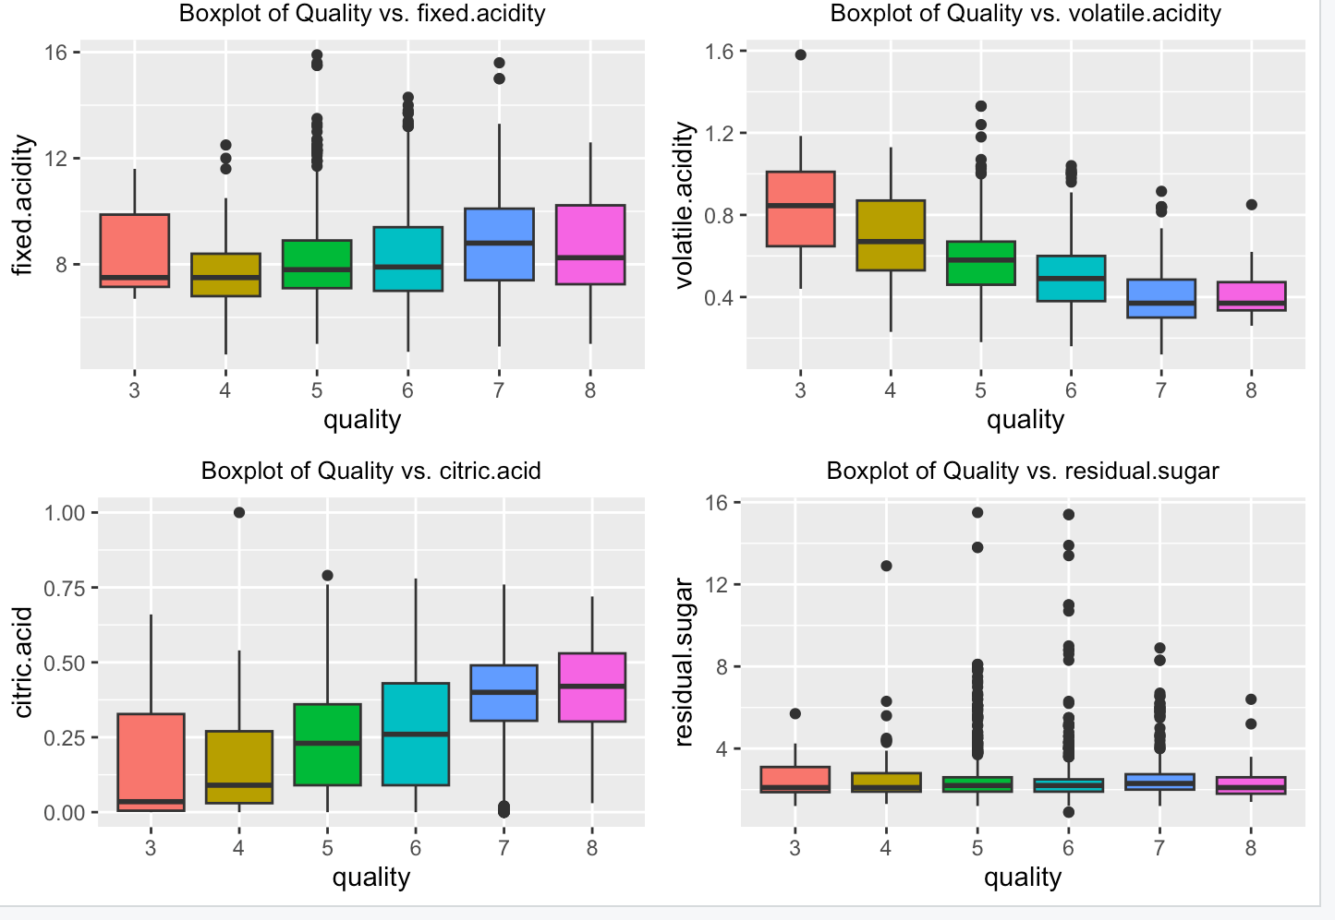
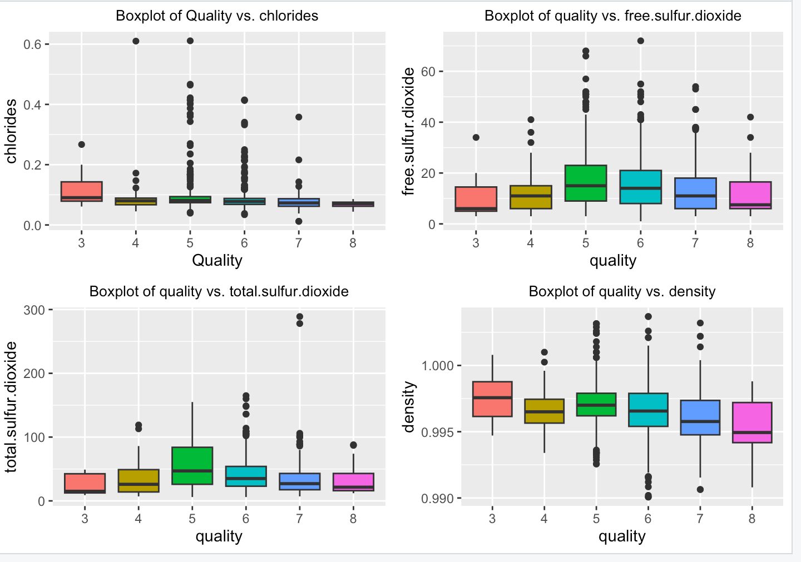
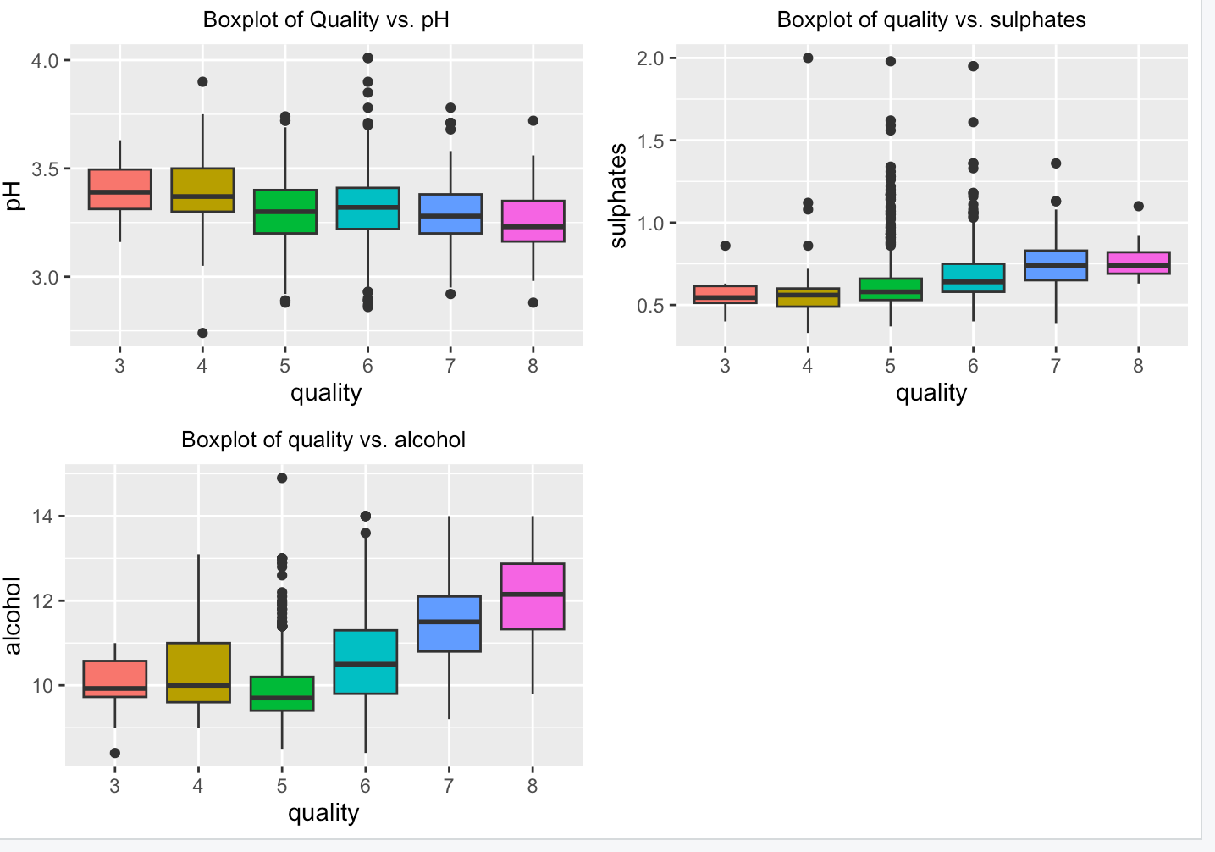
Data Analysis(Red wine):

Slide 10
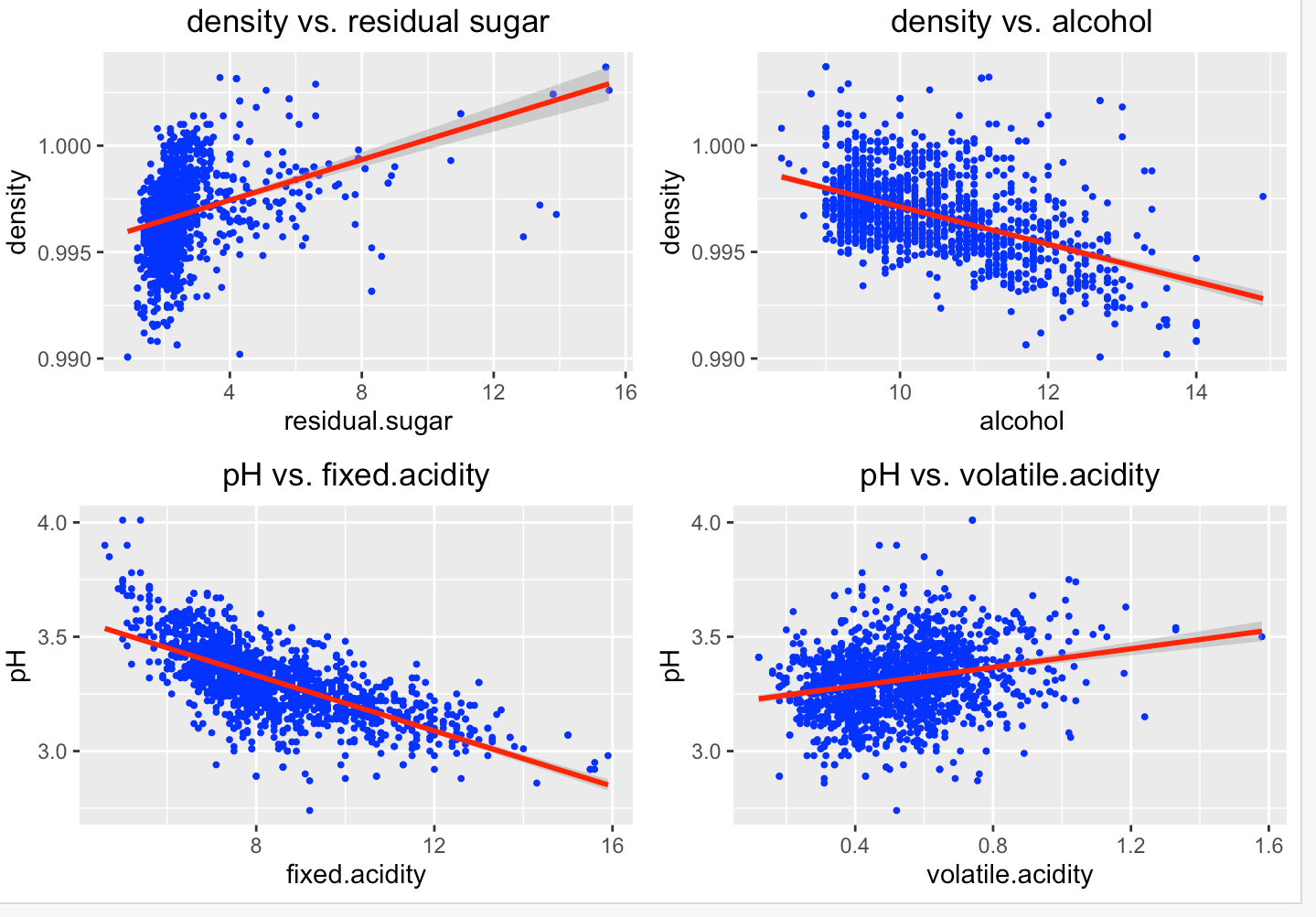
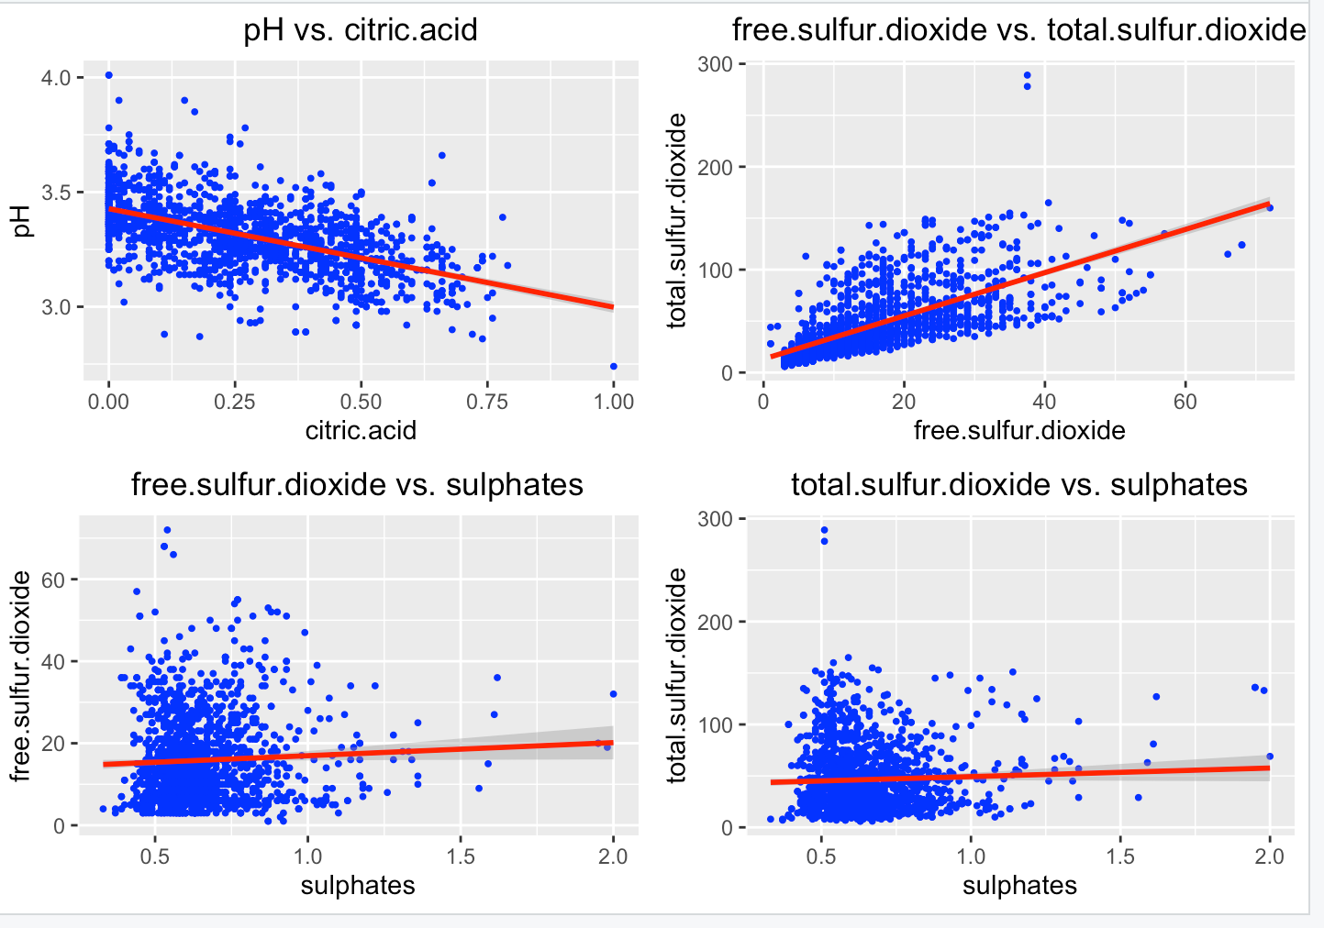
Linear regression of Red wine

Slide 11
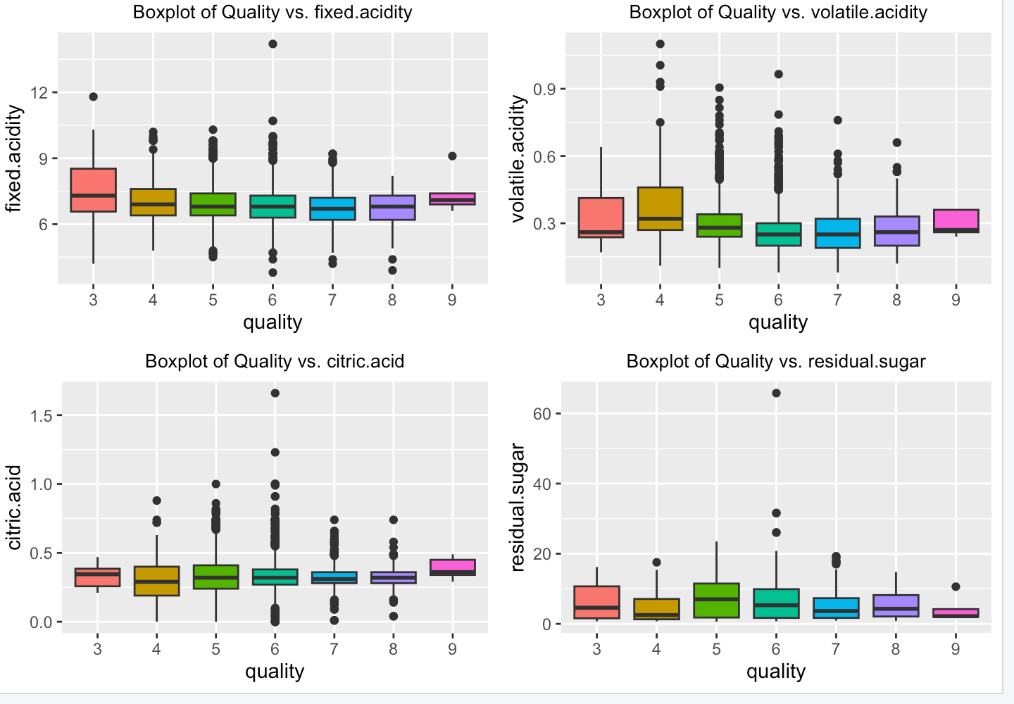
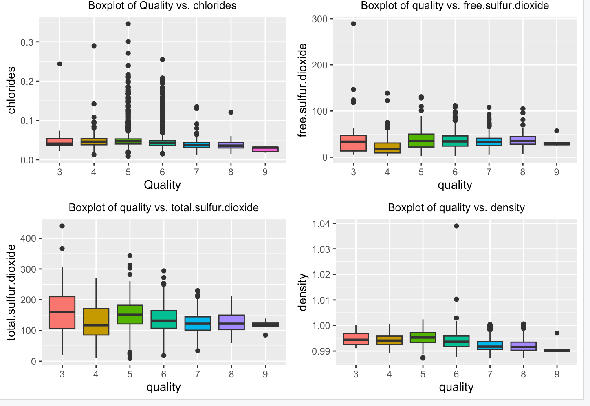
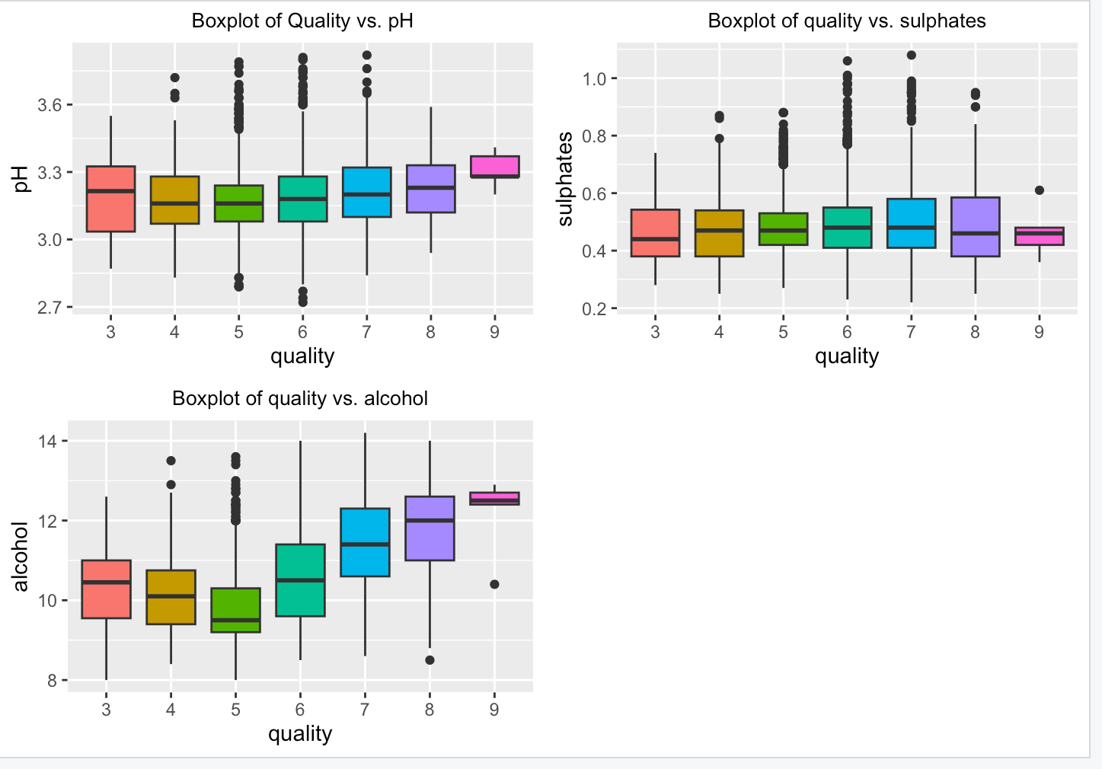
Data Analysis(White wine):

Slide 12
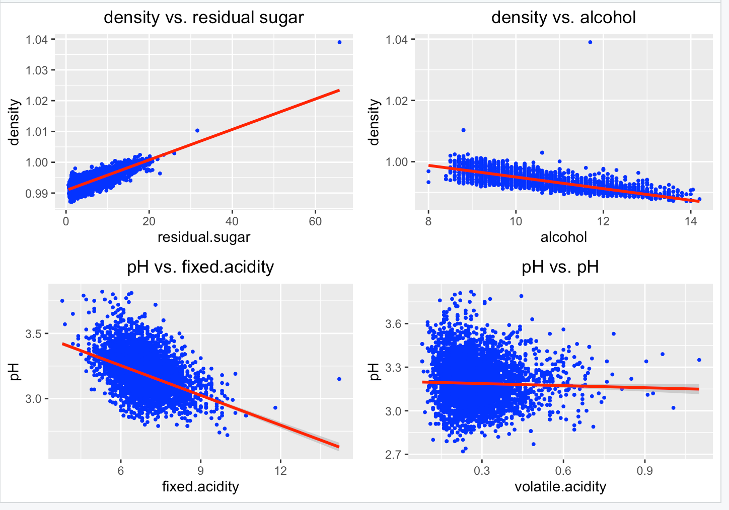
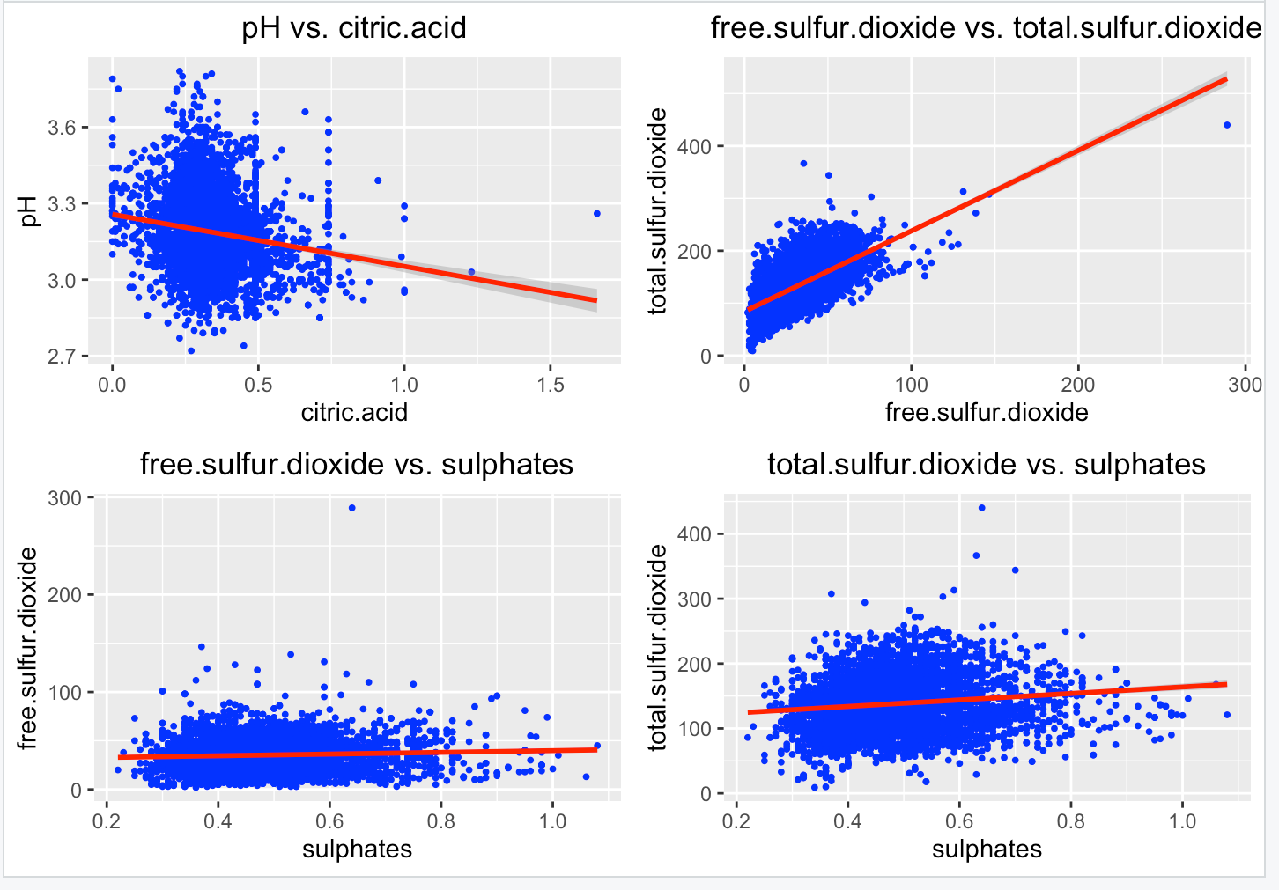
Linear regression of White wine

Slide 13
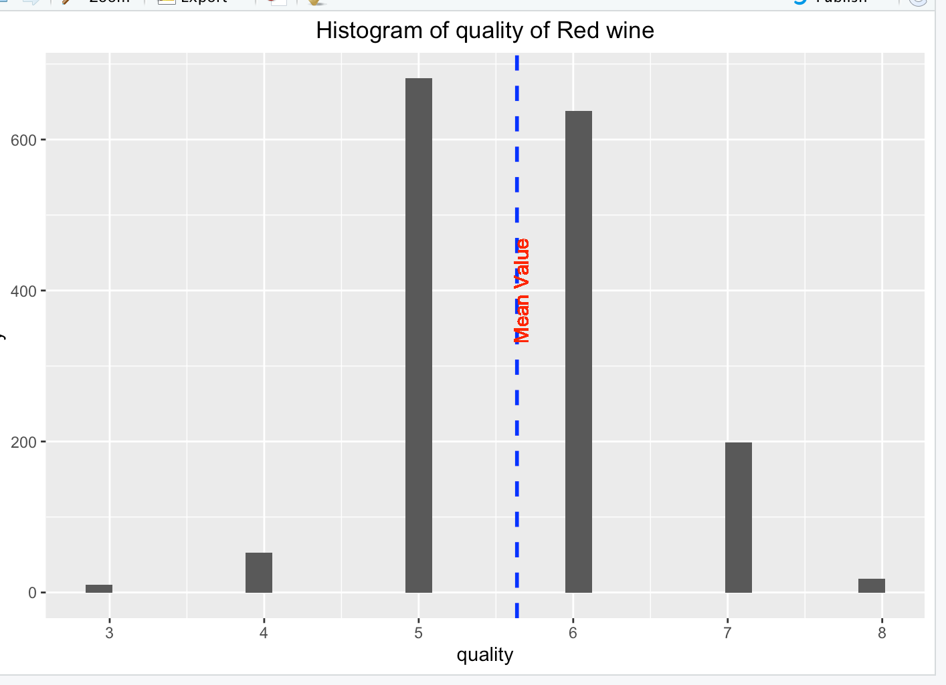
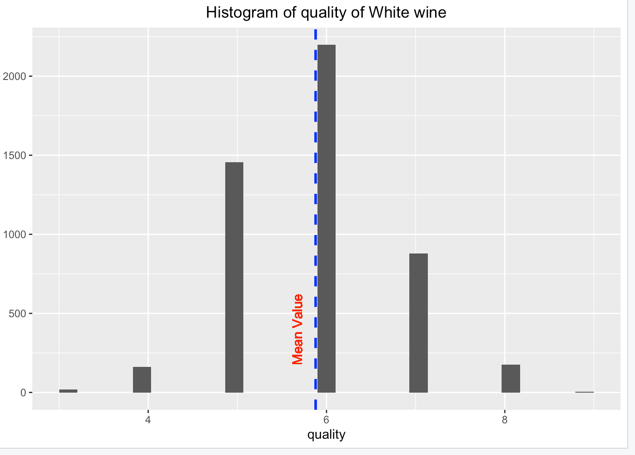
Comparing two types of wine

Slide 14
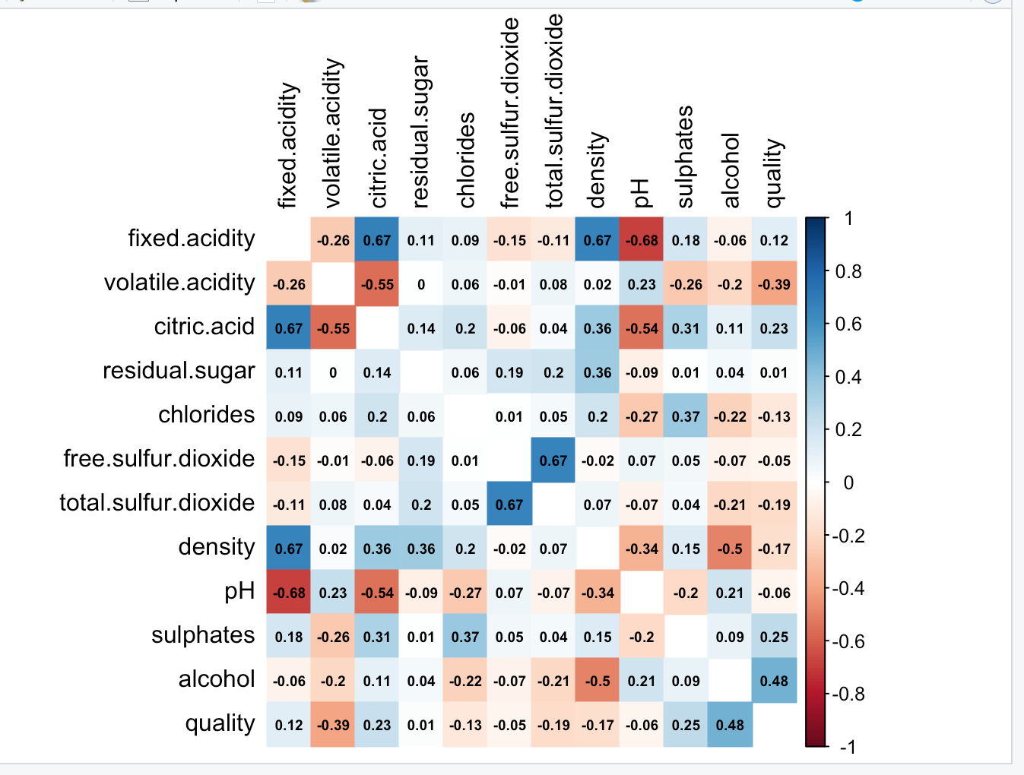
Correlation Matrix(Red wine)
red_dfcor <- cor(red_df)
corrplot(red_dfcor, method = "color", addCoef.col = "black",number.cex = .6,
tl.col = "black", tl.srt = 90, diag = FALSE)

Slide 15
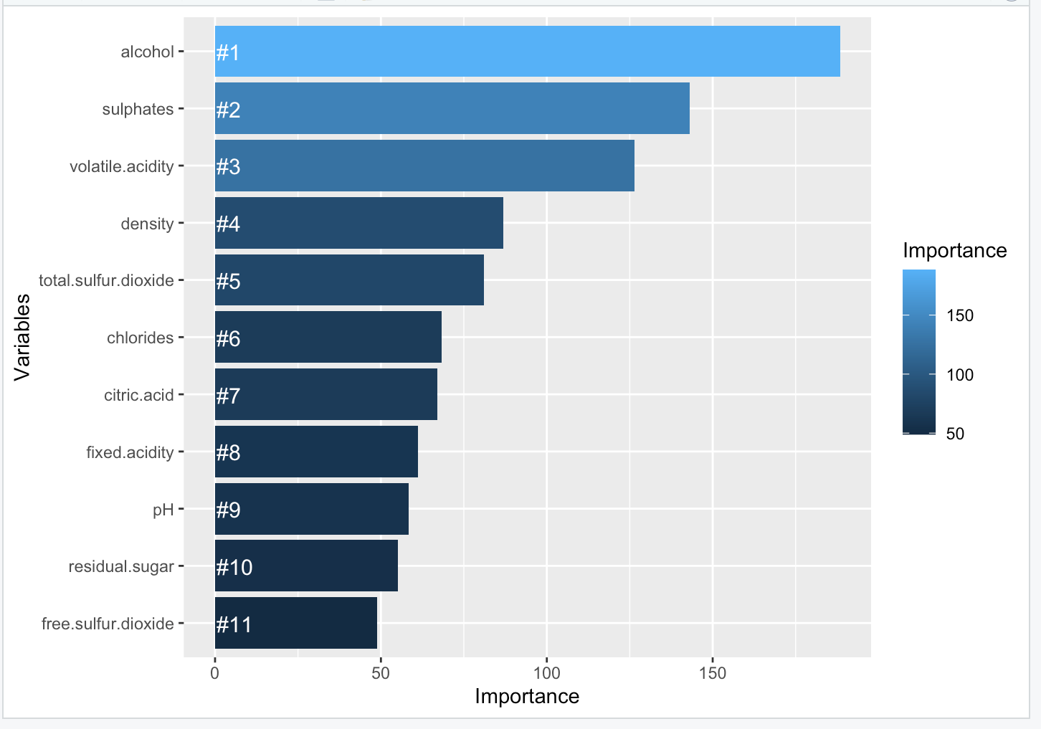
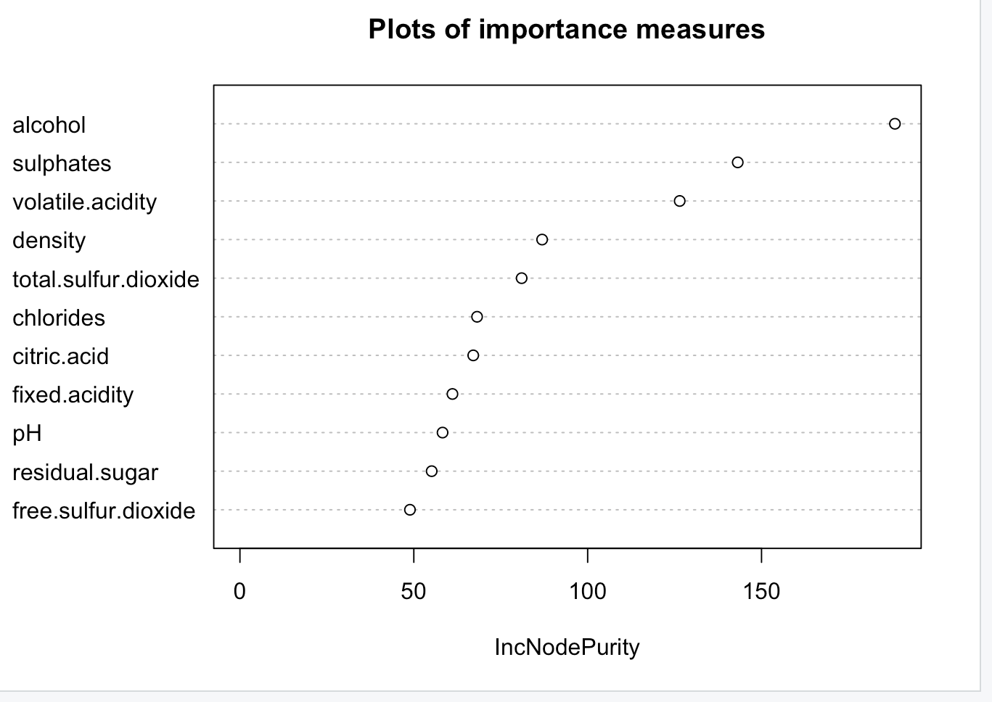

Slide 16
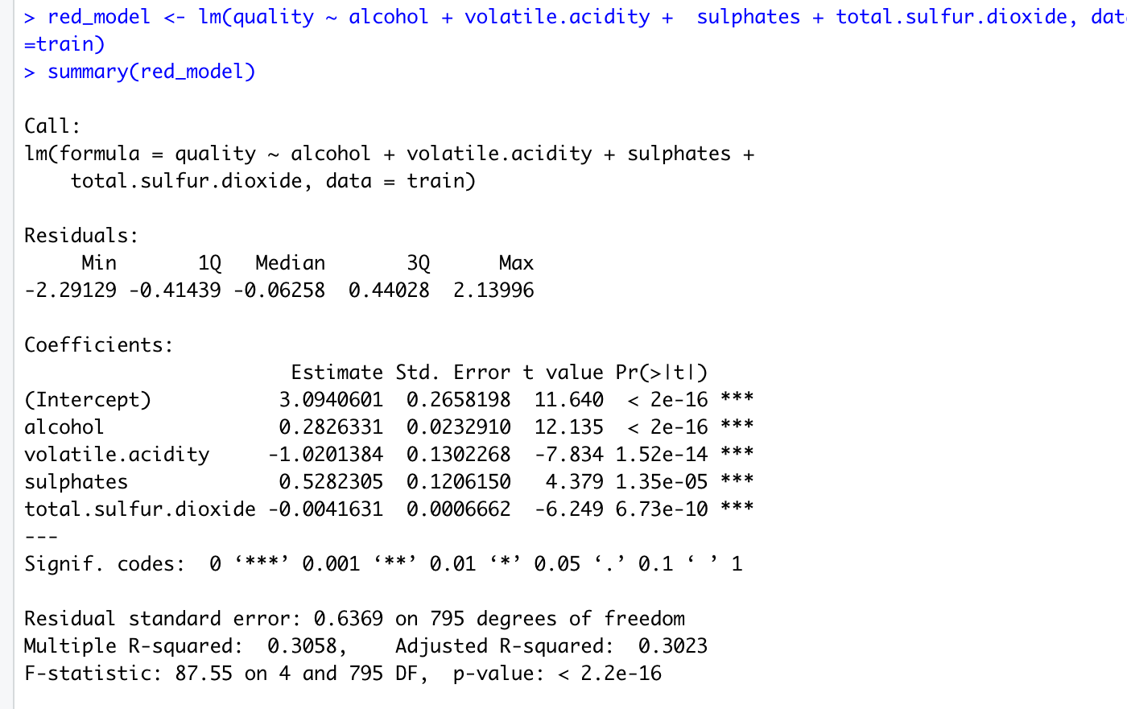
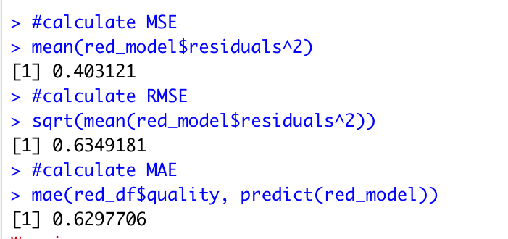
Linear regression

Slide 17
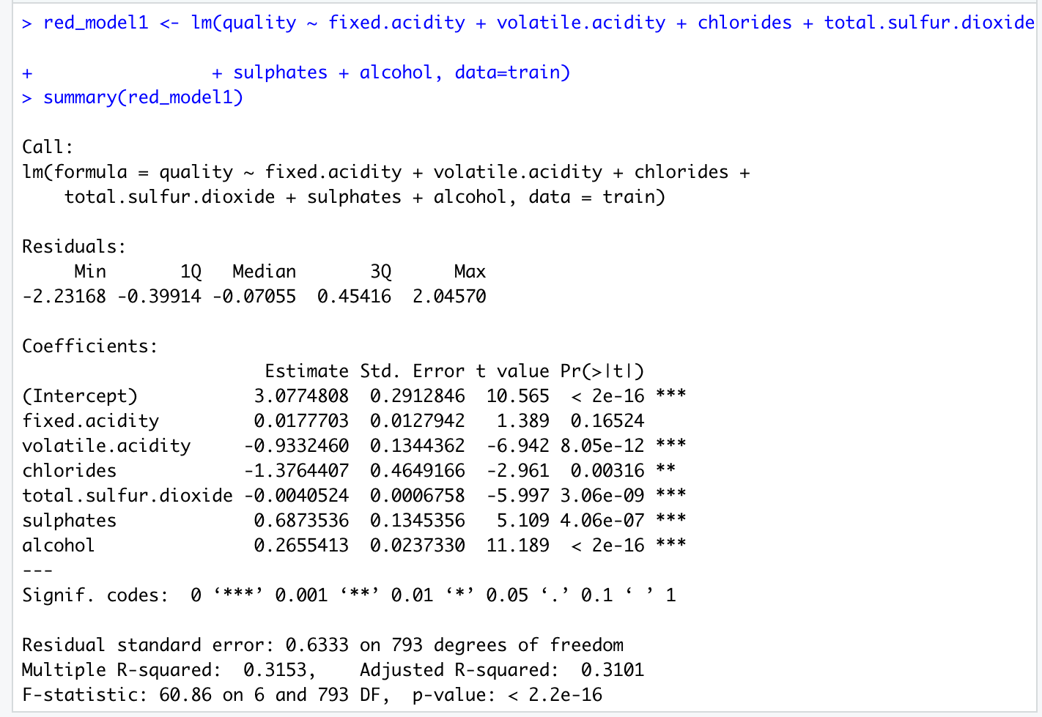
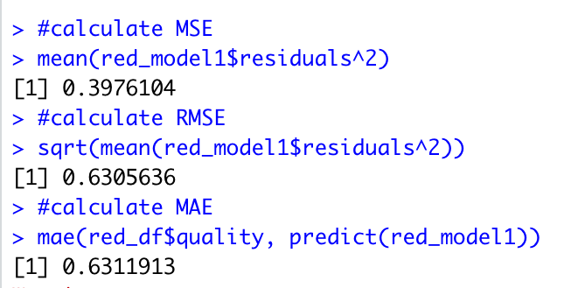
Lasso regression

Slide 18
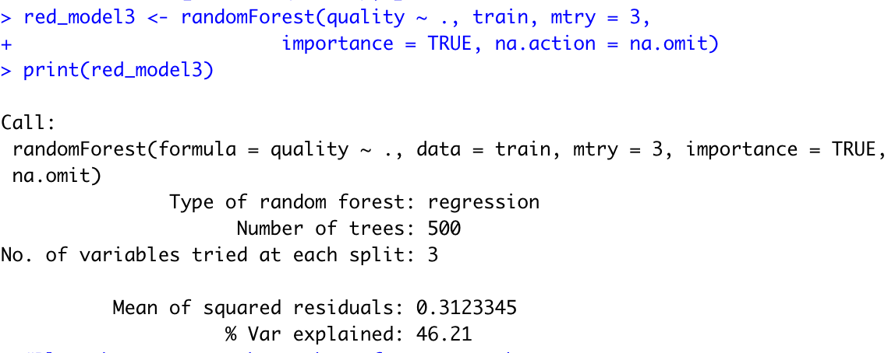
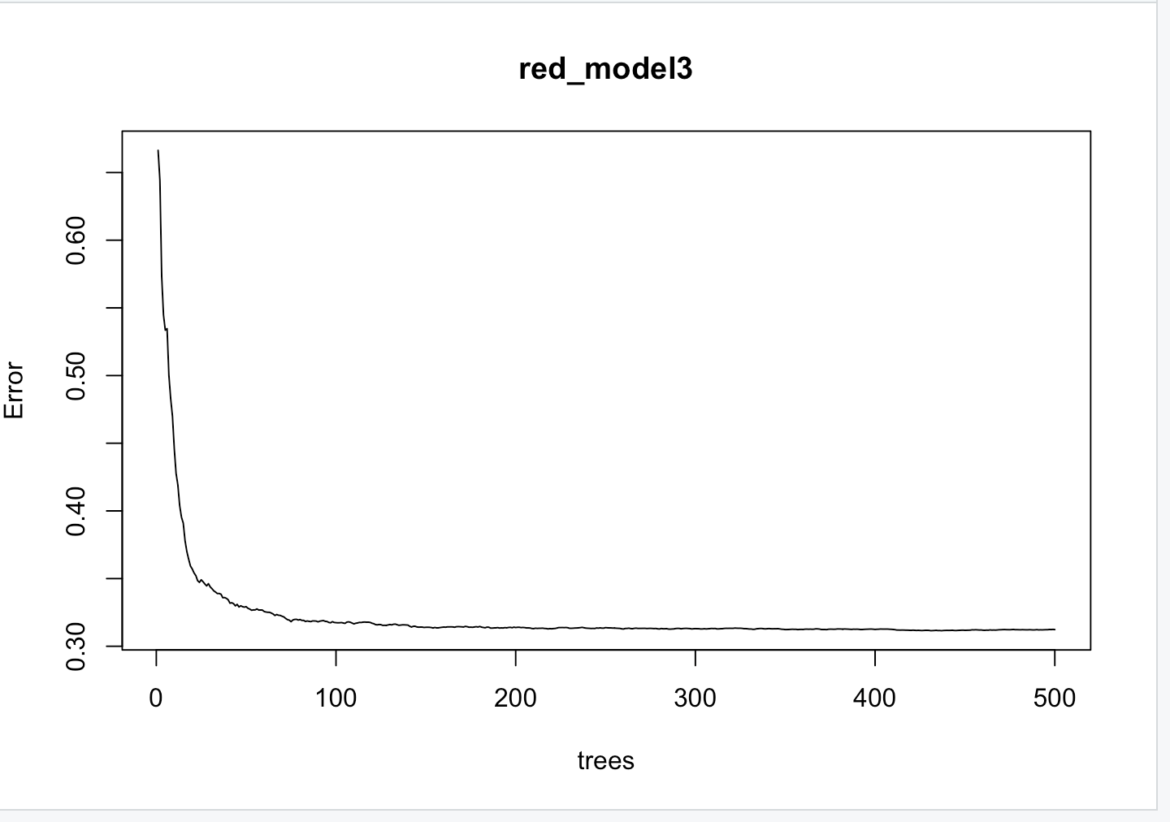
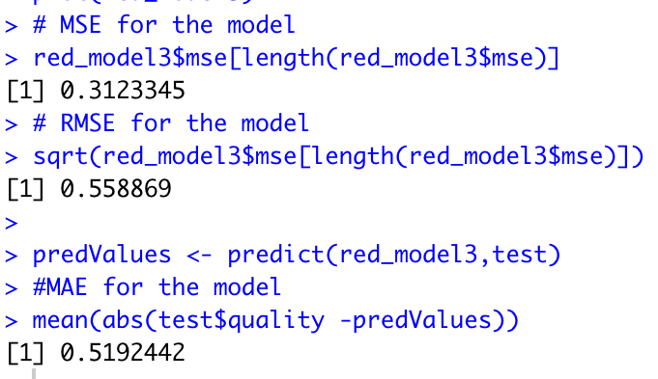
Random forest

Slide 19
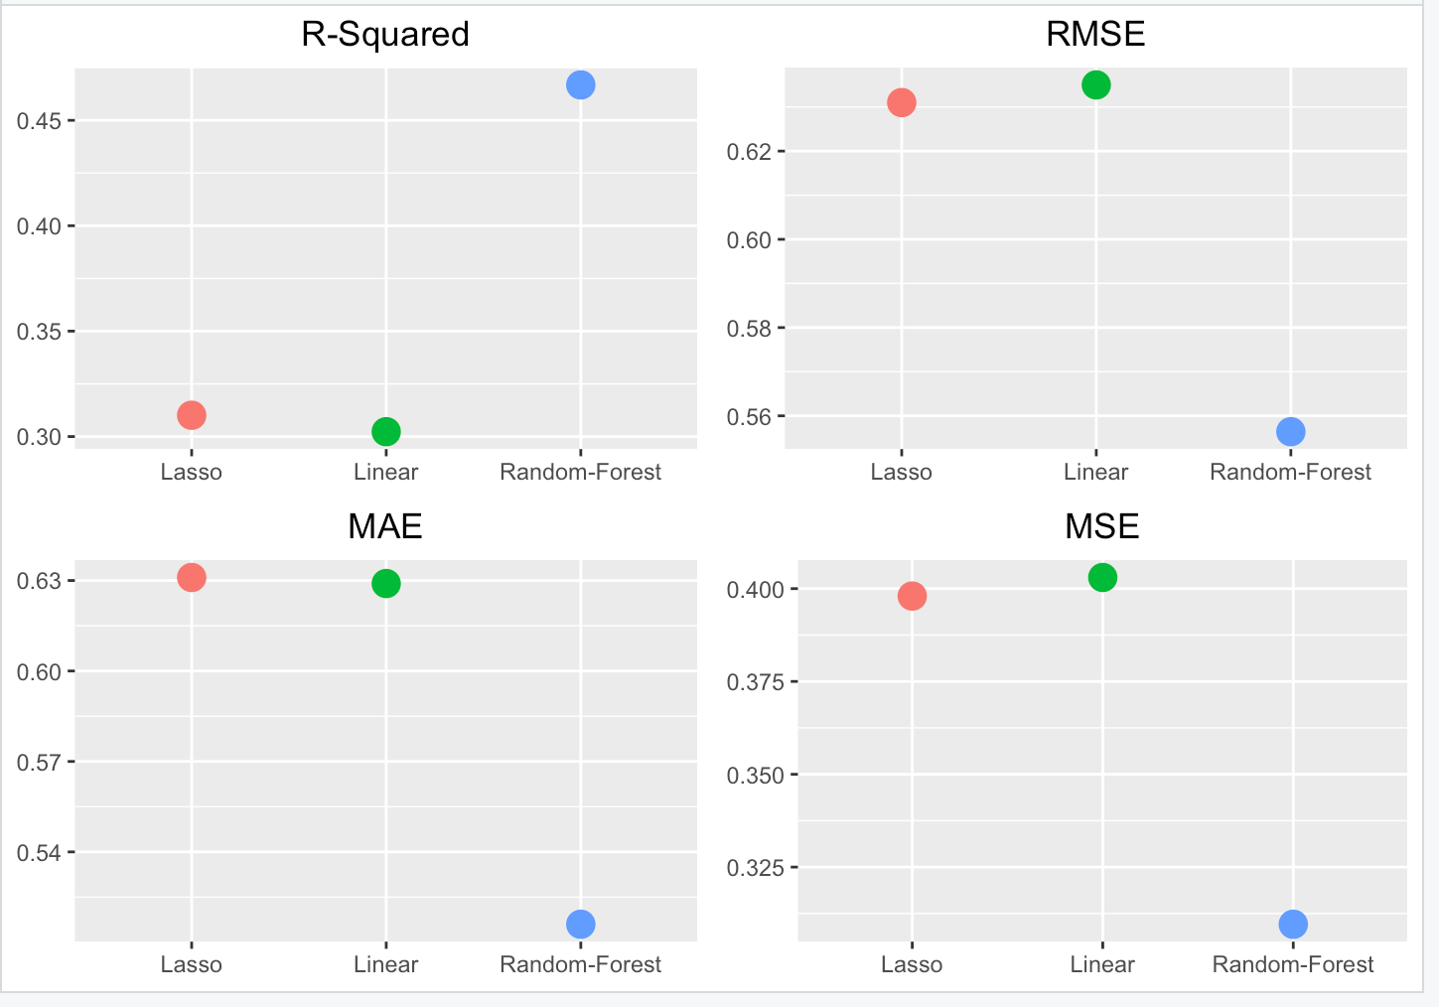
Regression models for Red wine

Slide 20
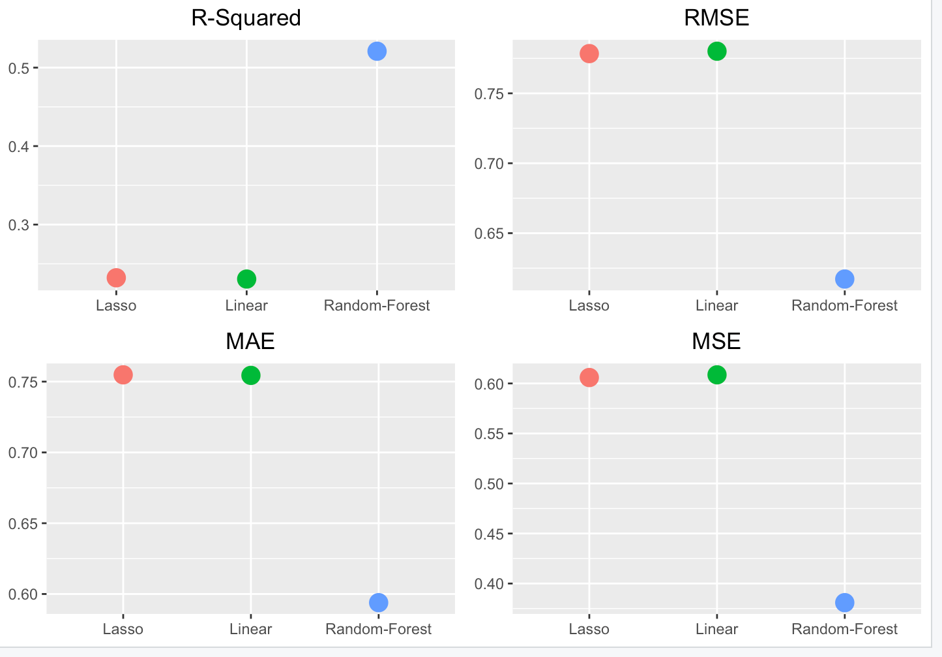
Regression models for White wine

Slide 21
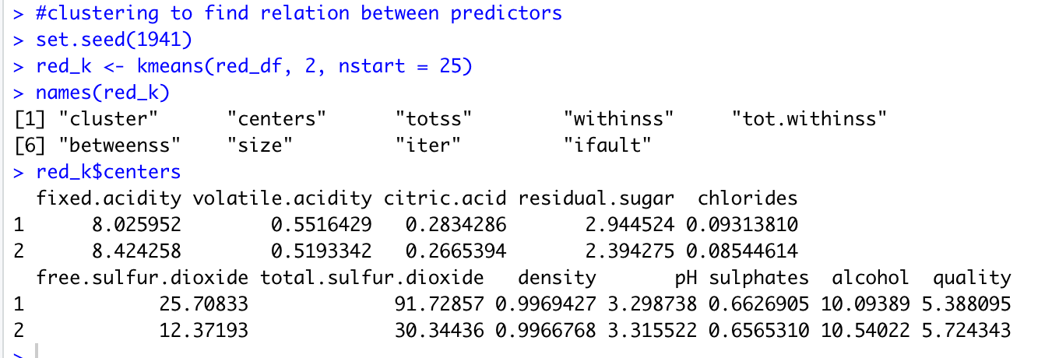
Clustering (Red wine)

Slide 22
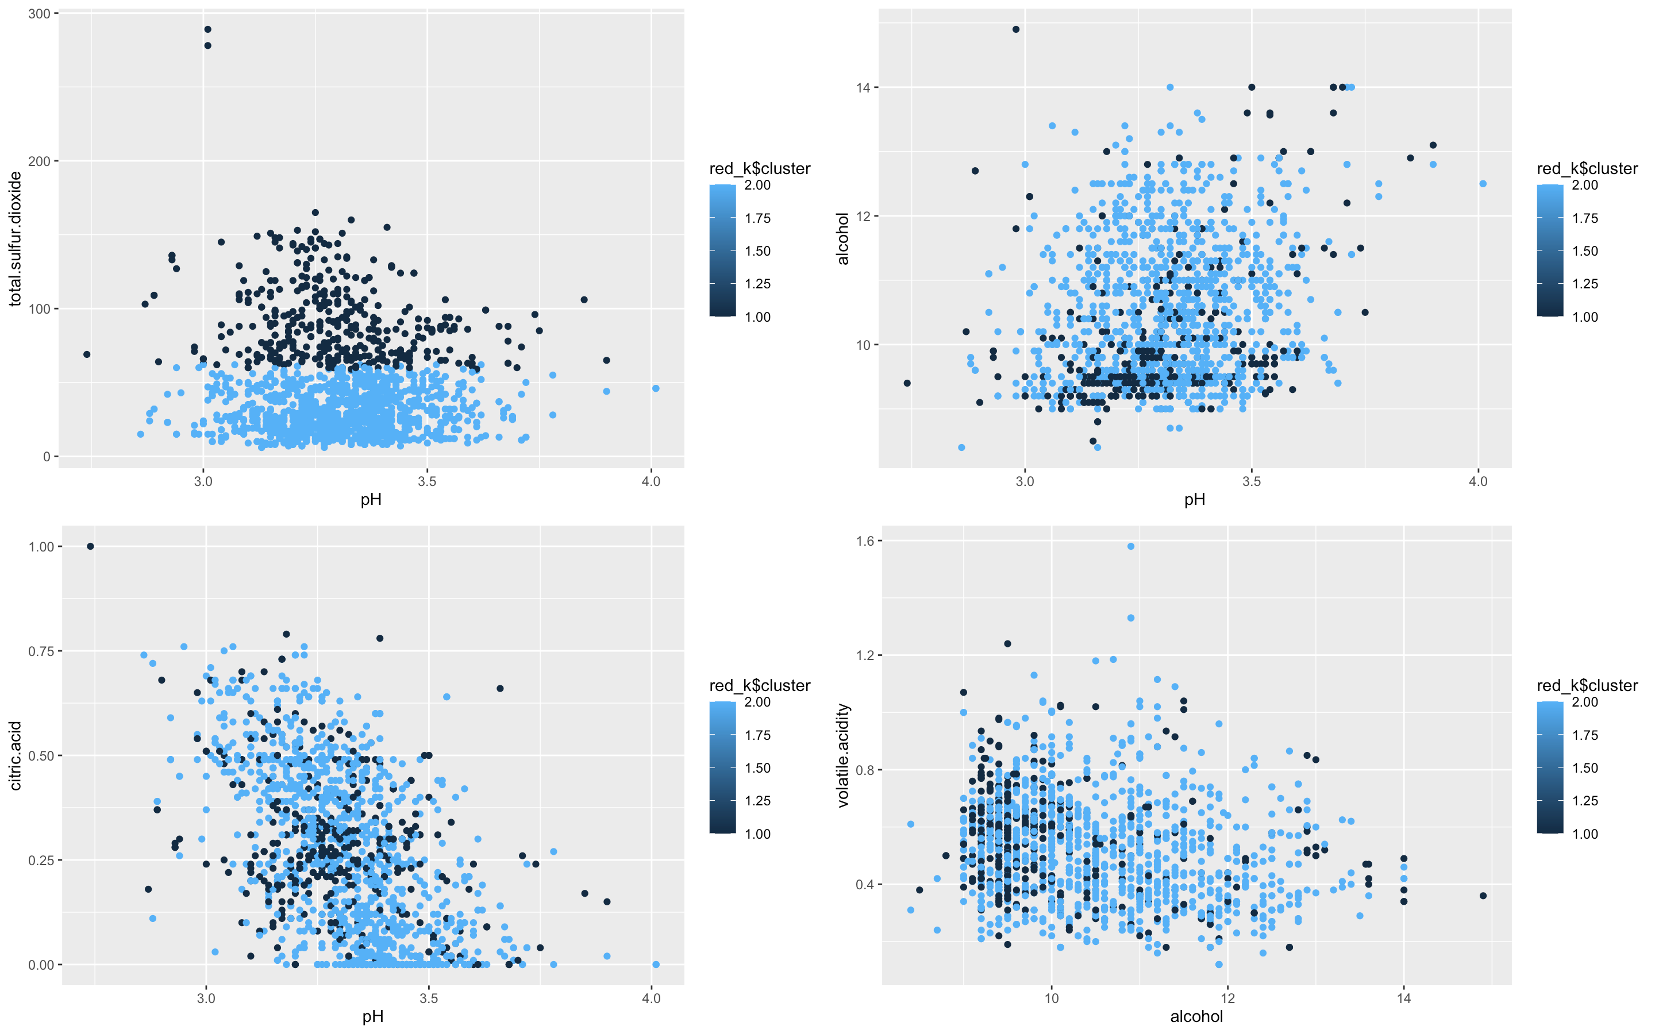

Slide 23
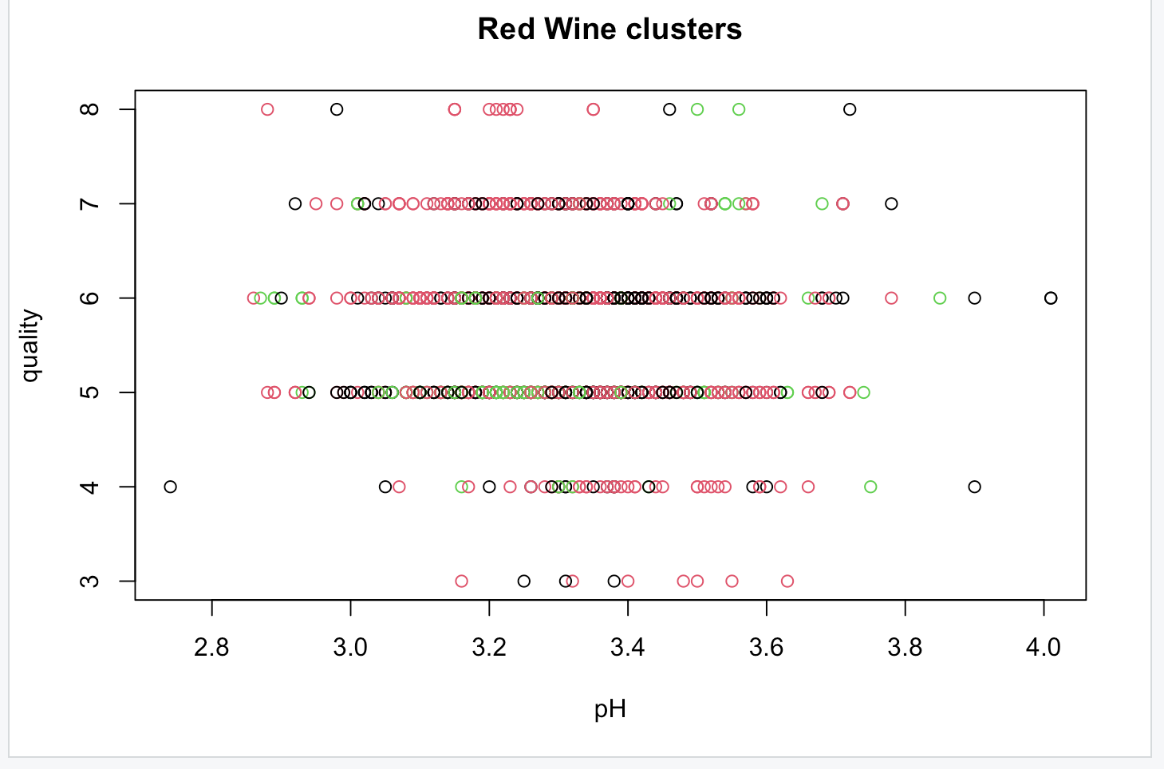

Slide 24
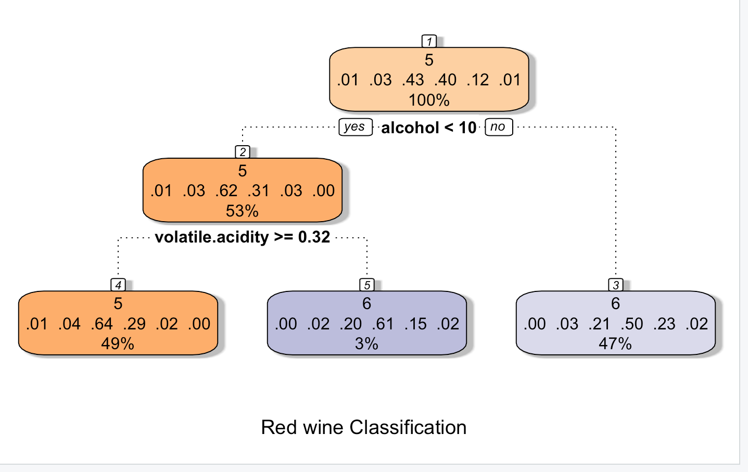

Slide 25
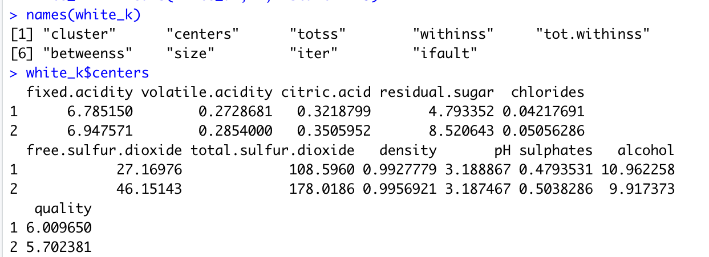
Clustering(White wine)

Slide 26
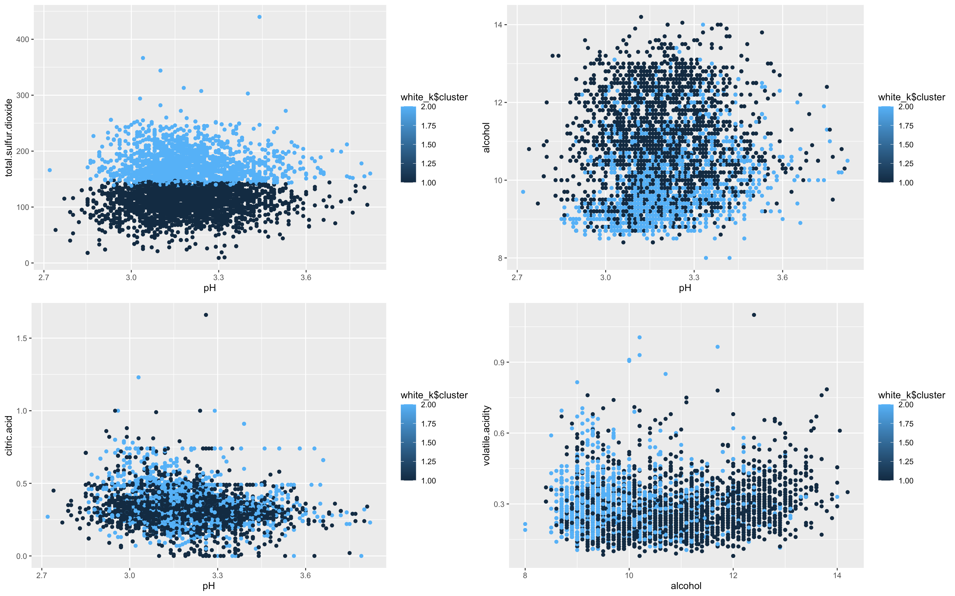

Slide 27
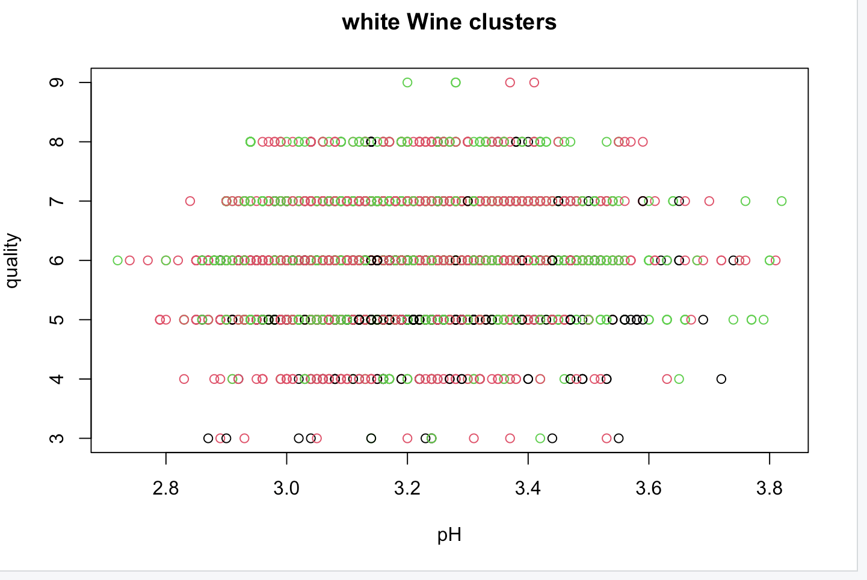

Slide 28
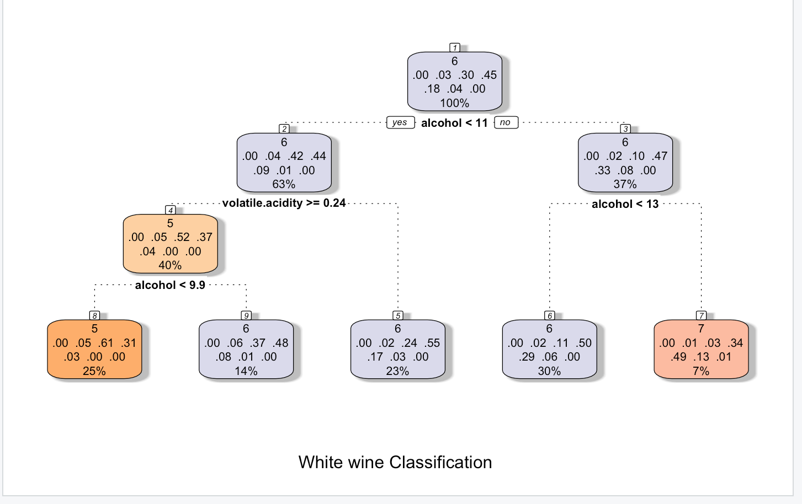

Slide 29
Results
According to the bar graphs, we can interpret that Red wine has more demand than White wine.
Through density plots, clusters and box plots we were able to relate predictors and understand their effect on quality.
With the help of correlation matrix we could estimate important predictors for promising results.
By creating different regression models and comparing them, we found out that random forest model is the most efficient.

Slide 30
Challenges
Quality of the wine doesn’t depend on one factor/variable. All variables have their own contribution . So I couldn’t explain at what pH the quality is similar for red and white wines.
The fundamental problem is that there are many predictors and variables, and it is difficult to determine which one is statistically significant enough to be a predictor. Also the predictors varied from red wine to white wine and it was challenging to keep track of both and compare them.
While the white wine dataset has 5000 values, the red wine dataset only has about 1600. Due to the differing numbers of values used to train the regression models, this makes comparison much more challenging.

